Slide 1
AI Trans-program
Kickoff Meeting
2017-12

Slide 2
agenda
1 | Overall introduction | David Zhu
2 | Project introduction | David Zhu
3 | Project Org | David Zhu
4 | Lead speech | Free discussion
5 | Delivery methodology | Free discussion

Slide 3
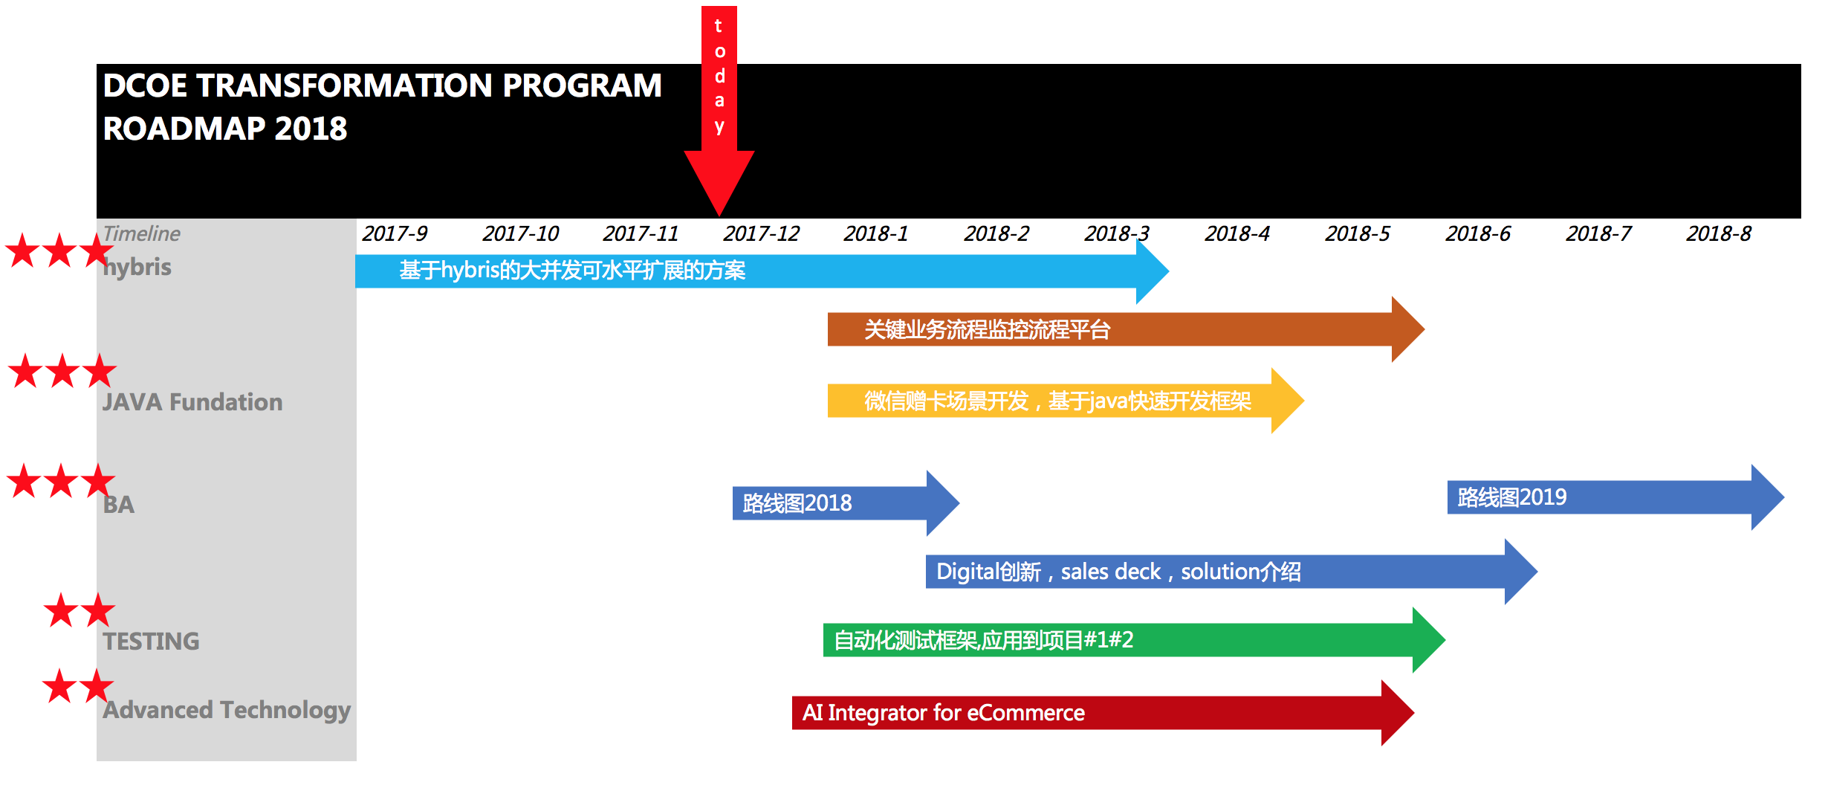
Transformation roadmap

Slide 4
A1. Hybris china accelerator3.0

Slide 5
SuperCart
Background:
Project super cart aims to build an extensible, session static service for hybris shopping cart. It can be parallel deployed to multiple hybris intances and providing static service for client side.
With super cart, cart calculation wont go to database to create thousands of sqls but using mem instead. Promotion calculation will only be in mem also.
Tangible assets:
Few java jars to extend OCC
Solution architecture design
Infrastructure design
Performance test report
Target client:
麦当劳
其他对购物车服务化有高扩展高可用需求的客户

Slide 6
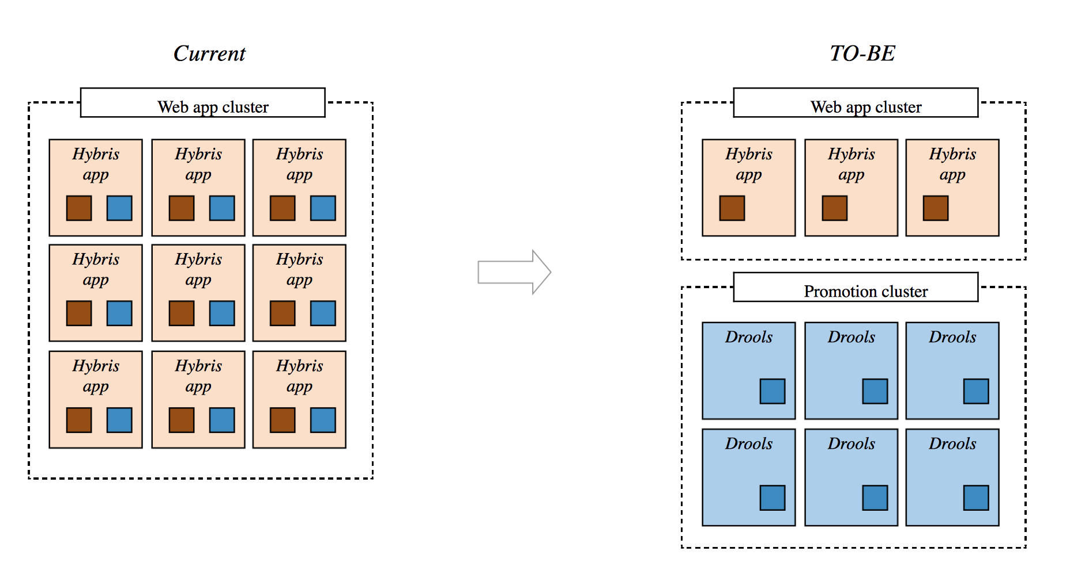
High level architecture

Slide 7
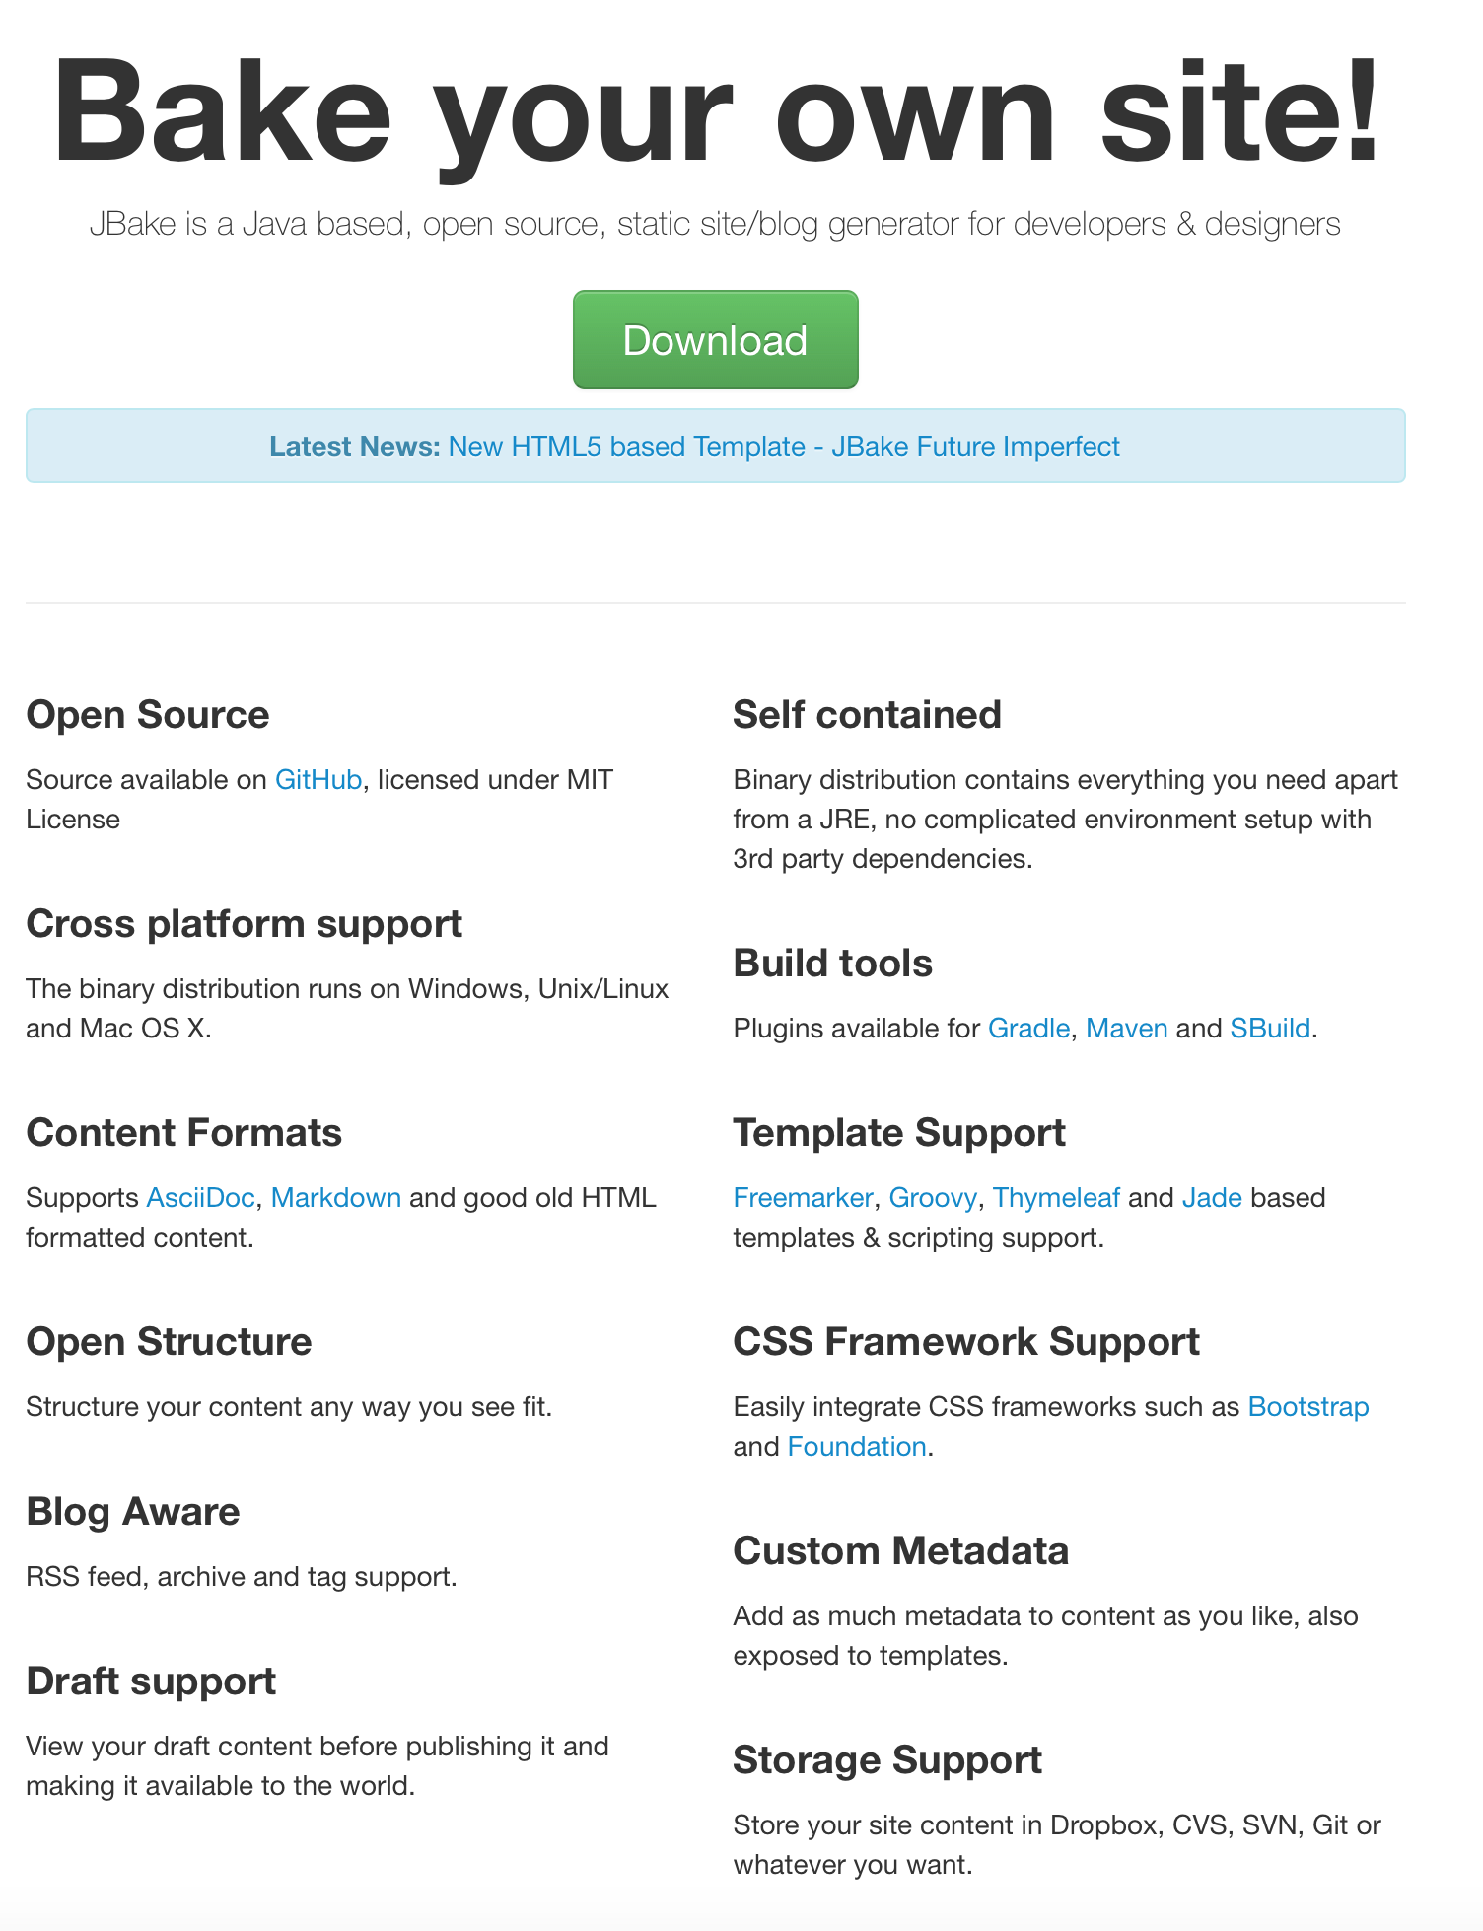
HTML generator
将动态网页静态化，可以有效减轻服务器端的压力，并且静态网页的访问速度要快于动态网页。此外，使用静态网页还有利于搜索引擎的收录，从而提高网站的搜索排名。
http://www.iteye.com/magazines/133-Static-Site-Generators
http://jbake.org JBake is a Java based, open source, static site/blog generator for developers & designers
。。。
Tangible assets:
A tool or an open source project finally being selected, which is able to convert hybris WCMS pages to HTML and functions correctly.
A PPT to describe PROs and CONs for most popular tools
Target client:
暂无
其他对购物车服务化有高扩展高可用需求的客户

Slide 8
A1 Team members
Role | Name | Additional Info
Lead | Mingming Wang
BA | Esther
SA | Junbin
Dev | Mingming

Slide 9
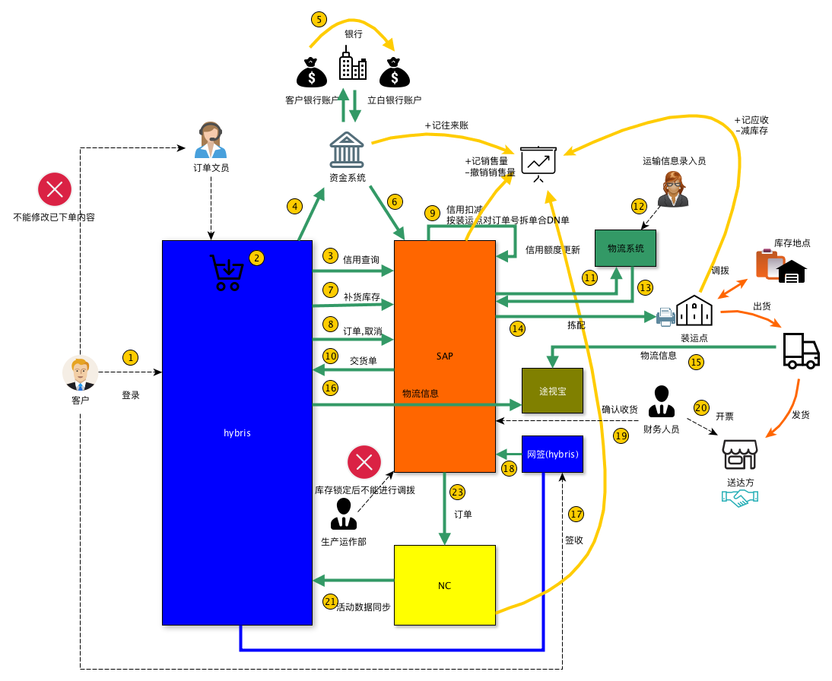
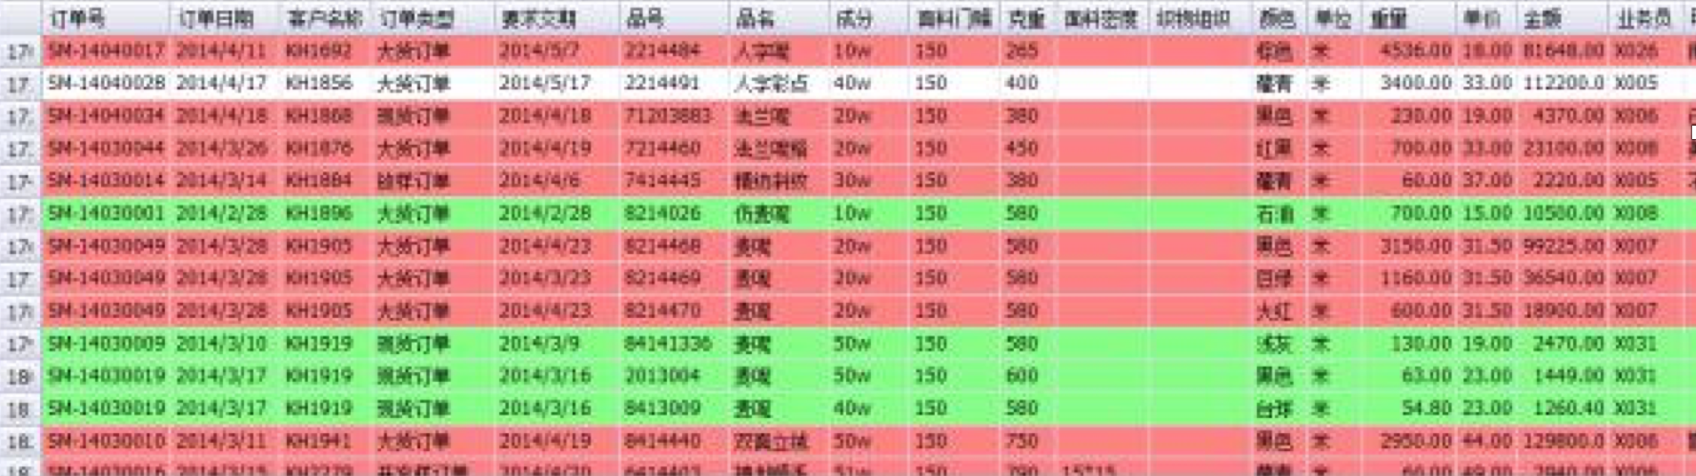
A2.关键业务流程监控平台

Slide 10
A2.关键业务流程监控平台
Tangible assets:
A hybris web extensions or backoffice extension to display cart/order/fulfillment pipeline and progress
Solution architecture design
Demo
Target client:
Liby
其他有订单监控流程需求的客户

Slide 11
A2 Team members
Role | Name | Additional Info
Lead | Kairong SU
BA | Bonnie Wang
Dev | Michael LI
Dev | Sigrid

Slide 12
A3.China commerce solution
China localization

Slide 13
China commerce solution based on yh
Jeff committed delivery outcome
Sean Koi from OG TC who are also working on this topic from couple months ago(GC/APAC)
Tianhao WU / Baojian / Kevin DU are working on China eCommerce solution building(GC)
Max, senior manager who is from Itally Milano, currently setting up commerce team in Jap(APAC/Golbally)

Slide 14
Don’t reinvent wheel
Optional
Can we find more partners in China market considering they already delivered many successful cases?
Collaborate with other china local service provider?

Slide 15
A3 Team members
Role | Name | Additional Info
Lead | Hongwei Xiao
SA | Tianhao WU
Dev
Dev

Slide 16
A4. AI integrator

Slide 17
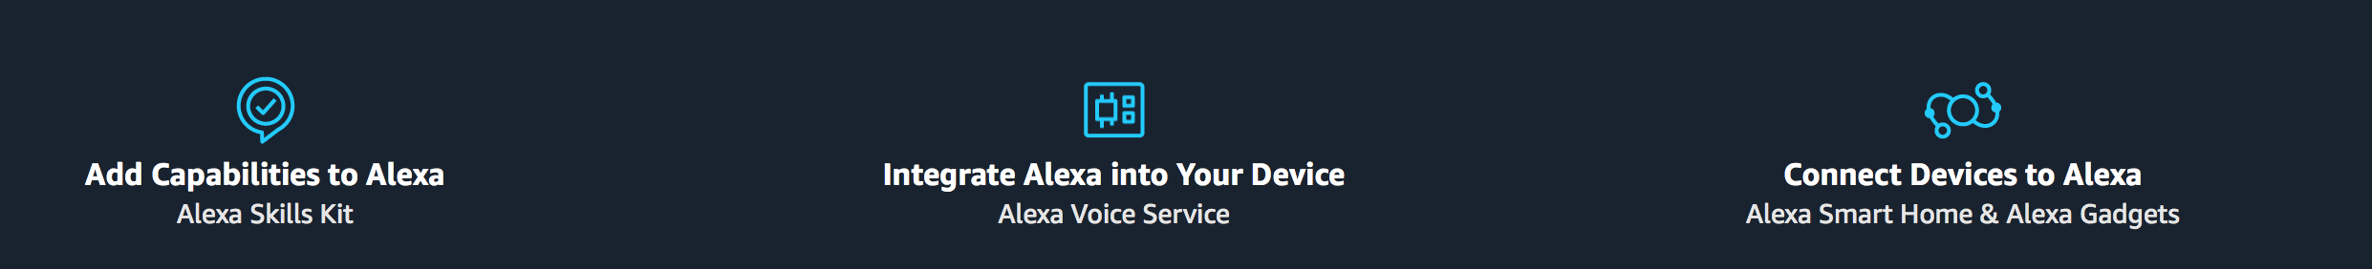
IFTTT深度集成：亚马逊Echo迎来可定制声控命令支持
http://tech.huanqiu.com/news/2015-11/8066701.html
亚马逊Echo接入教程
http://www.arduino.cn/thread-31891-1-1.html

Slide 18
A4 Team members
Role | Name | Additional Info
Lead | Xudong LIN
SA | James SHI
Dev | Liu KAI
Dev | Havey

Slide 19
Open source

Slide 20
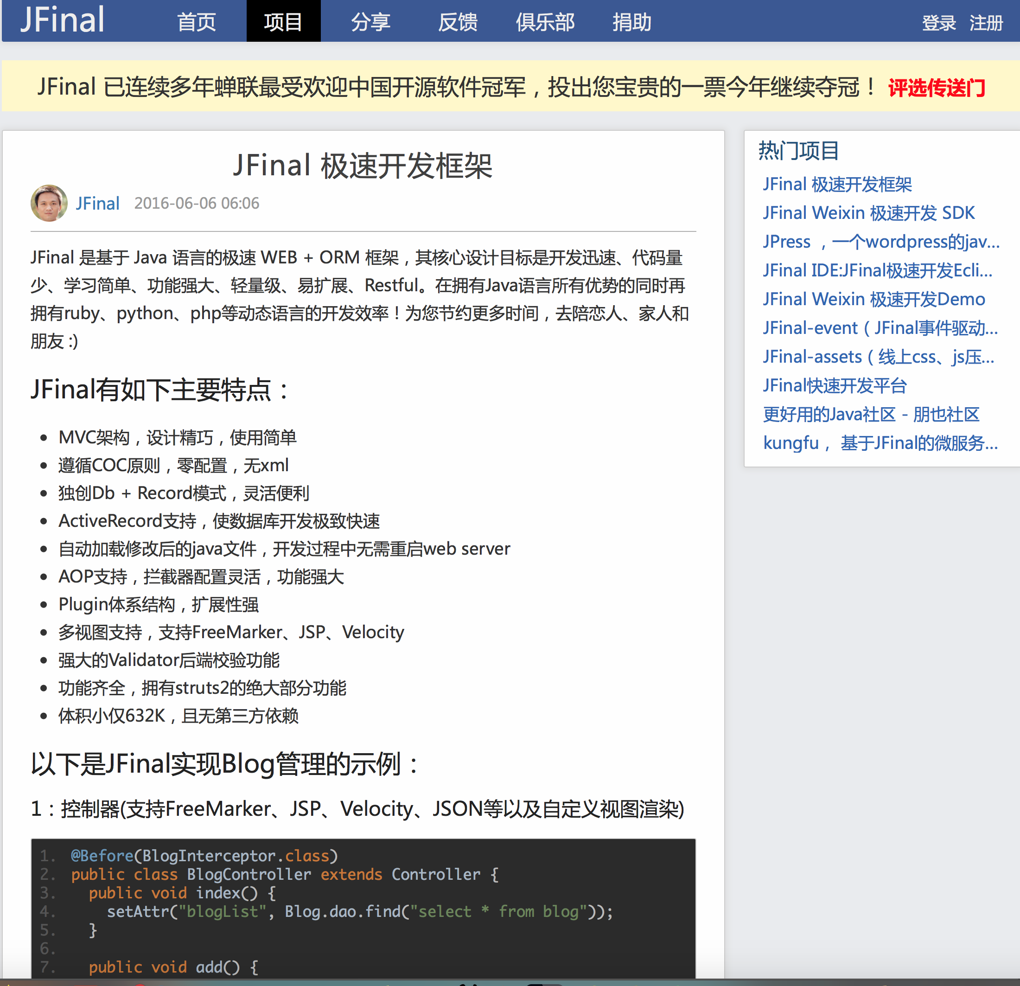
a java web dev kit
Seeking for smart and quick way for the purpose of Cost effective
JFinal 极速开发框架
JFinal 是基于 Java 语言的极速 WEB + ORM 框架，其核心设计目标是开发迅速、代码量少、学习简单、功能强大、轻量级、易扩展、Restful。在拥有Java语言所有优势的同时再拥有ruby、python、php等动态语言的开发效率！为您节约更多时间，去陪恋人、家人和朋友 :)
JFinal有如下主要特点：
MVC架构，设计精巧，使用简单
遵循COC原则，零配置，无xml
独创Db + Record模式，灵活便利
ActiveRecord支持，使数据库开发极致快速
自动加载修改后的java文件，开发过程中无需重启web server
AOP支持，拦截器配置灵活，功能强大
Plugin体系结构，扩展性强
多视图支持，支持FreeMarker、JSP、Velocity
强大的Validator后端校验功能
功能齐全，拥有struts2的绝大部分功能
体积小仅632K，且无第三方依赖
http://www.jfinal.com/project/1

Slide 21
Spring boot
Spring cloud

Slide 22
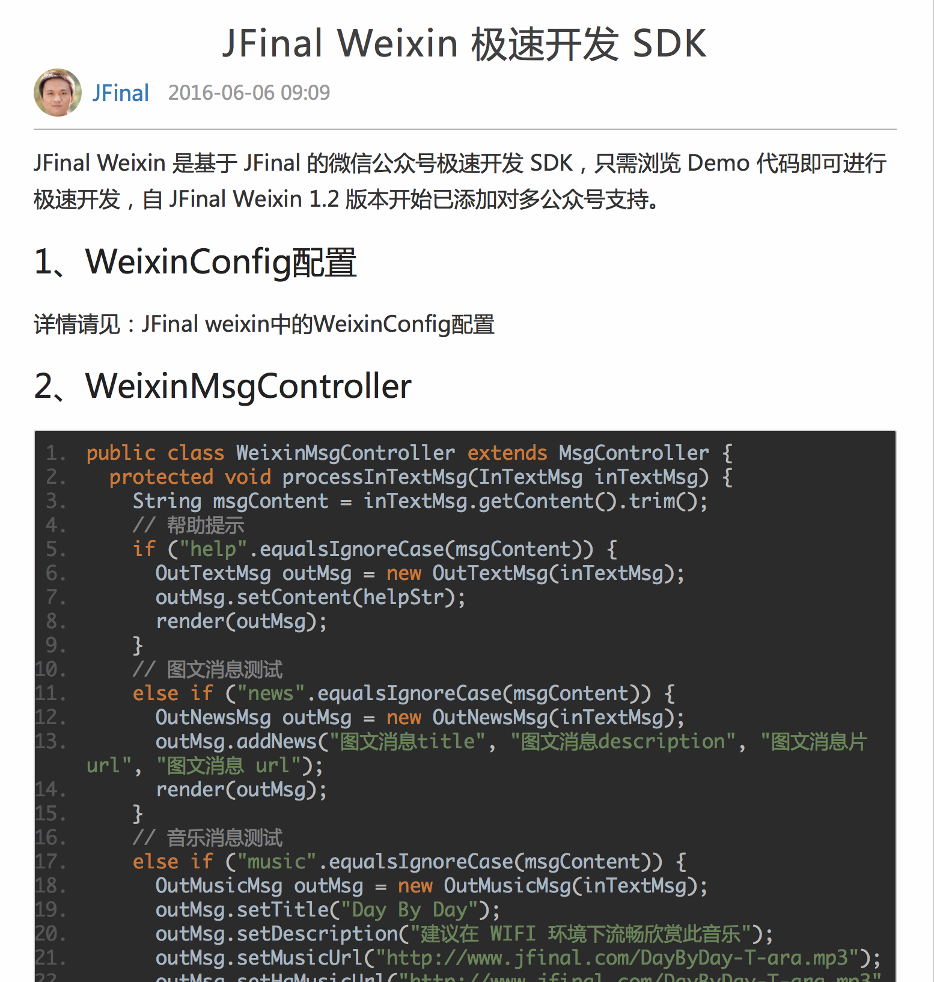
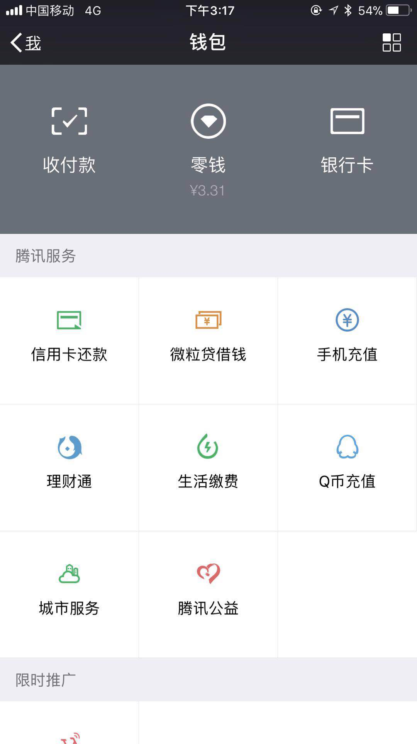
a java based weixin dev kit
JFinal Weixin 极速开发 SDK
JFinal Weixin 是基于 JFinal 的微信公众号极速开发 SDK，只需浏览 Demo 代码即可进行极速开发，自 JFinal Weixin 1.2 版本开始已添加对多公众号支持。
http://www.jfinal.com/project/2
https://gitee.com/jfinal/jfinal-weixin/wikis/Home
Notes:
Demo how to send a gift card to a friend
A purchased a gift card from Starbucks
Share gift card with B
B accepted and it shows in My Cards of wechat
B redeemed gift card in store by sweeping the card

Slide 23
A5 Team members
Role | Name | Additional Info
Lead | Jin Liang
BA | Qiumin
SA | Matthew ZHU
Dev | Aizhen

Slide 24
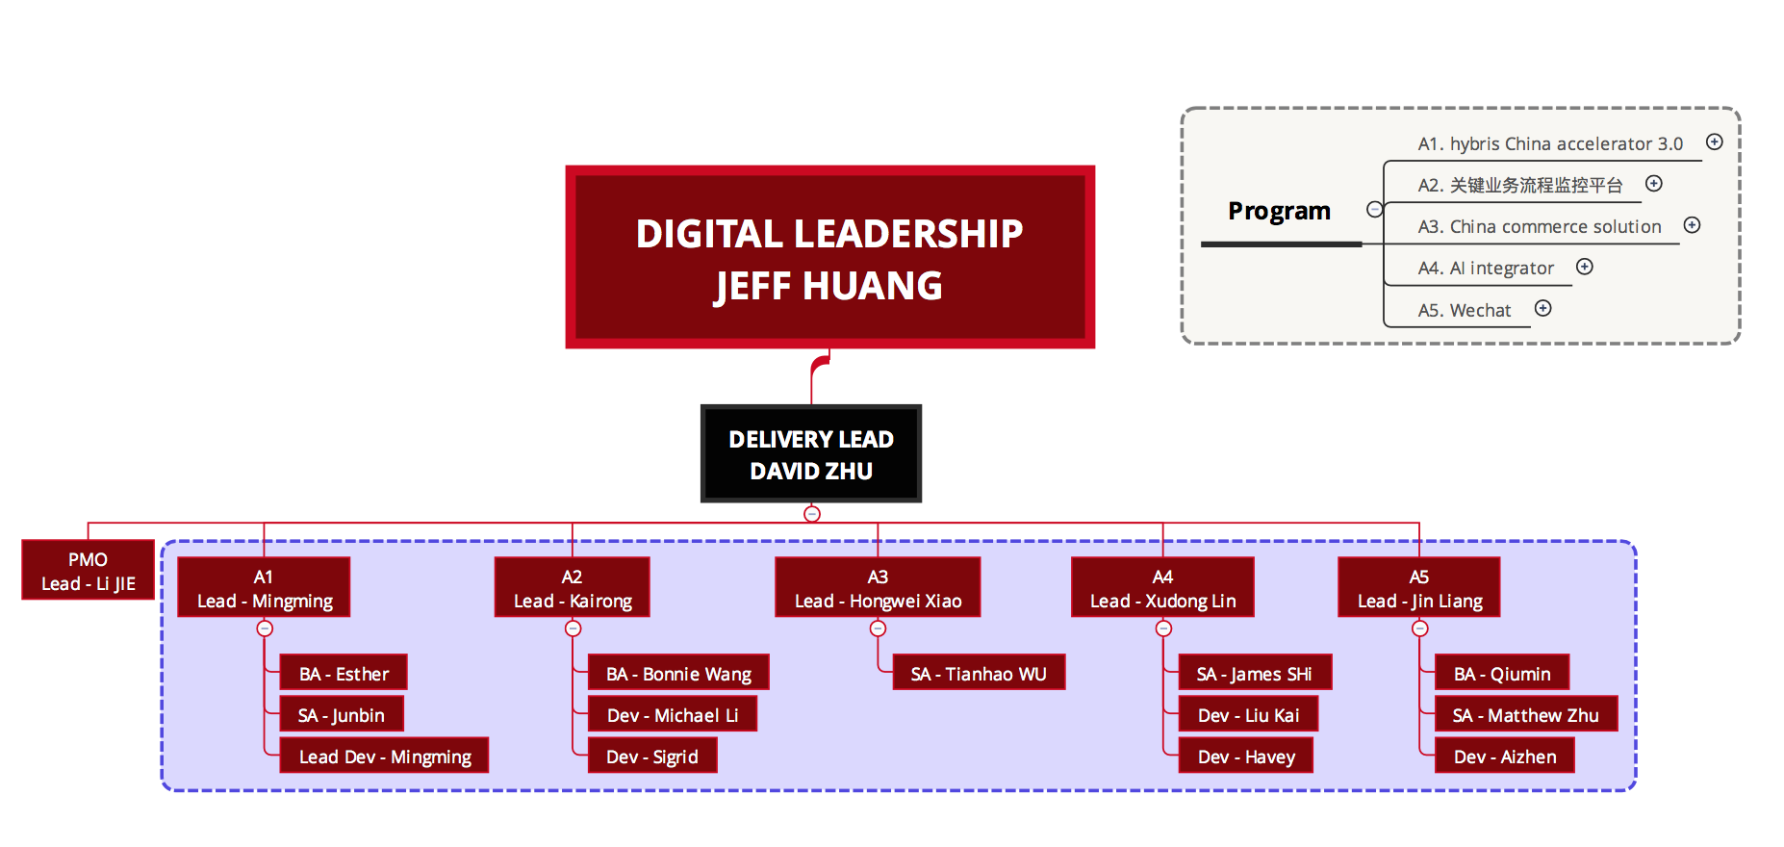
The facts is that by 2017-12-6
5 Projects
18 Members from different projects

Slide 25
Leader speech
A1 – Mingming
A2 – Kairong
A3 – Hongwei
A4 – Xudong
A5 – Jin Liang

Slide 26
Delivery methodology
Meeting(Wechat / F2F / Coffee Meeting)
Working time (Off / Working day)
Report by weekly
Expense

